Slide 1





Here’s a clear “diagram-style” breakdown for both Android and iPhone. Part 1 is to help you find the option, and Part 2 is for creating the home screen button.
M11.1
M13.2
M14.1
M15.3
M16.2

Slide 2

Here’s a clear “diagram-style” breakdown for both Android and iPhone. Part 1 is to help you find the option, and Part 2 is for creating the home screen button.

Slide 3
Here’s a clear “diagram-style” breakdown for both Android and iPhone. Part 1 is to help you find the option, and Part 2 is for creating the home screen button.

Slide 4
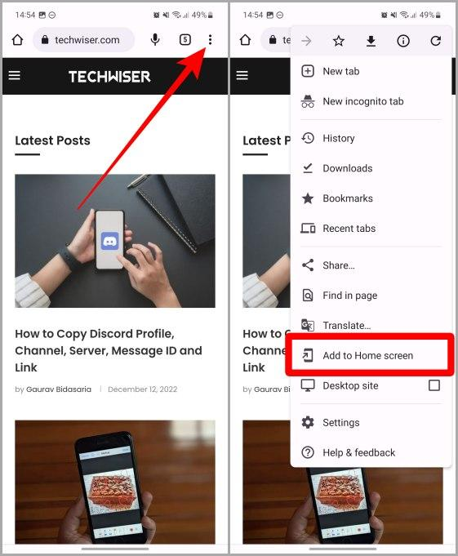
ANDROID (Chrome) Part 1: Open the website menu
1. Open Google Chrome
2. Go to the website you want
3. Tap the 3 dots (⋮) menu in the top-right corner

Slide 5
Part 2: Add to Home Screen 1. Tap “Add to Home screen 2. (Optional) Edit the name
3. Tap Add 4. The website icon now appears on your home screen like an app

Slide 6
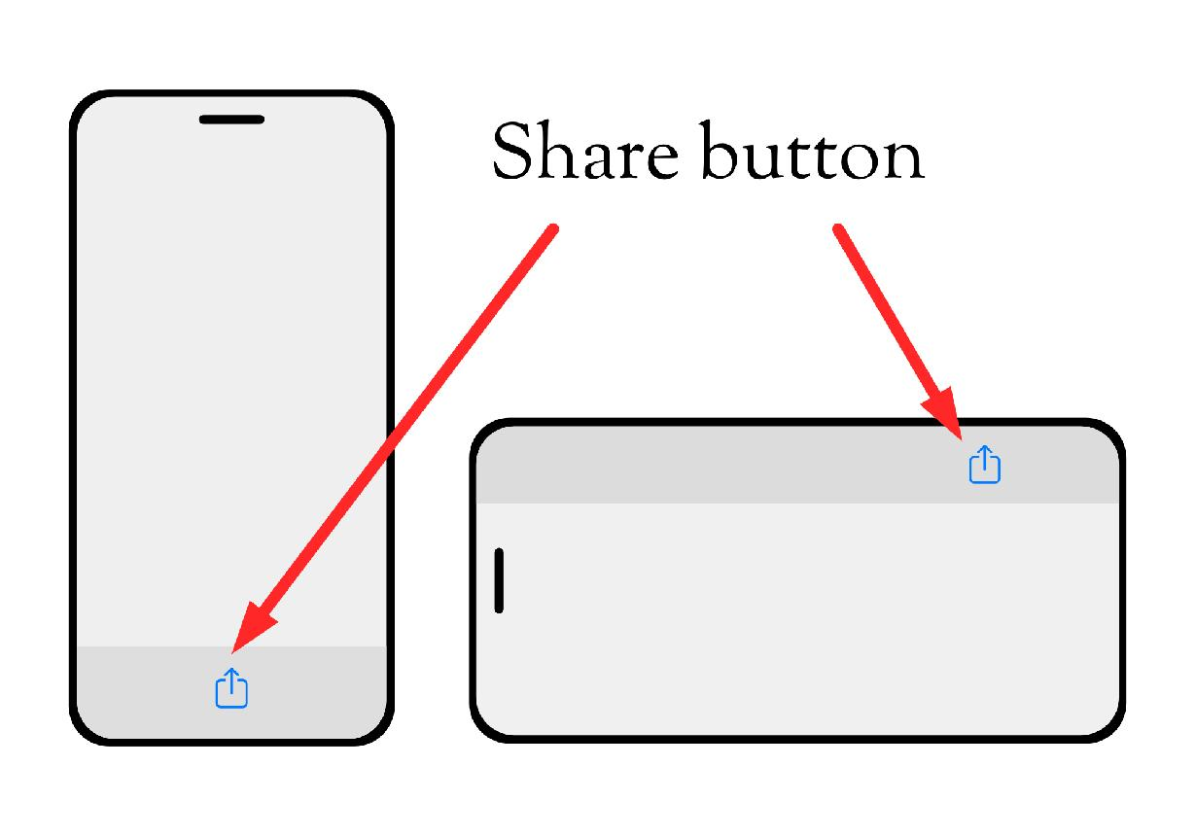
iPHONE (Safari)
Part 1: Open Share Menu
1. Open Safari
2. Go to the website you want
3. Tap the Share button (square with arrow up) at the bottom

Slide 7
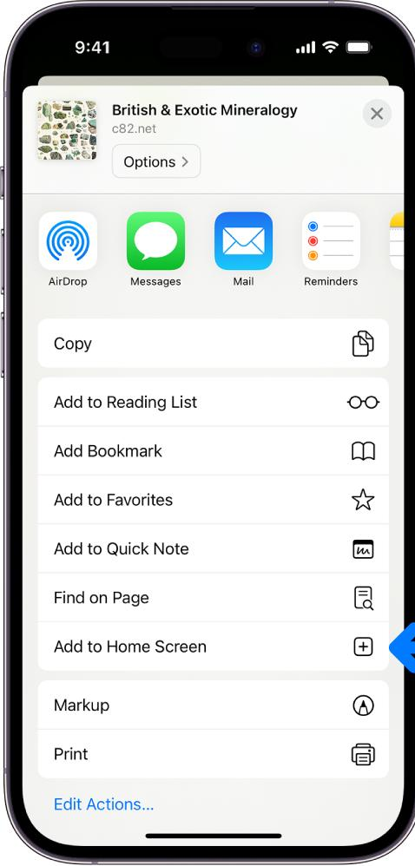
Part 2: Add to Home Screen
1. Scroll down in the share menu
2. Tap “Add to Home Screen”
3. Rename if you want
4. Tap Add
5. The website now appears as an app icon on your home screen.

